Slide 1

CSE 4939W Final Presentation Wi-Fi Connected Chess Boards
Kyle Jameson, Nick Kraus, Mark Mauriello, Maurice Wallace

Slide 2

Our Project/Purpose
Wireless chess board interaction
Chess server
Automatically moved pieces on opposite board
Realism of physical chess

Slide 3
Basic Features
Board State
Opponent Connection: Python Server (Reconnection Troubleshooting)
Opponent Communication: Sending State
Move Recognition/Legality: C program
Game Completion: Checkmate Detection
Piece Graveyard: Place for removal/ Pawn promotion
Error Notification: Error codes sent for troubleshooting

Slide 4

Electrical System
Overview
Powered by a Cypress ARM Cortex-M microcontroller and ESP8266 Wi-Fi module.
The microcontroller reads and writes to IO blocks which power the peripherals.
The microcontroller and physical hardware will be interfaced with special circuitry.
Wi-Fi module acts as bridge between the microcontroller and server.
Wi-Fi module and microcontroller communicate over a serial bus.

Slide 5

Electrical System (Continued)
Peripherals
Reed switches will determine if a piece is on a chess space or not.
Stepper motors and an electromagnet will be used to move the chess pieces.
Limit switches will provide homing information for the stepper motors.
An LCD display will show important information to the user.
A rotary encoder will allow the user to interface with the board.
Progress
Schematic has been designed and reviewed.
Circuit has been laid out on a printed circuit board.

Slide 6
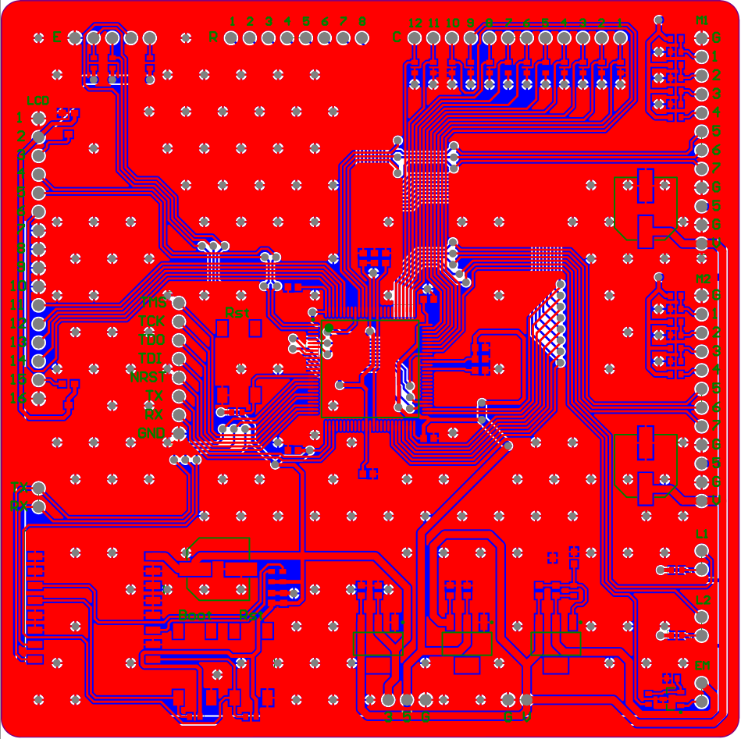

Slide 7

Mechanical System
Overview
An xy gantry will provide movement for the electromagnet and chess pieces.
Two stepper motors will control movement on the gantry.
An h-bot style gantry will be used to save vertical space.

Slide 8

Client Software (UI)
Overview
Firmware running UI
Controls mechanical system
Progress
Virtual Python Client
LCD display

Slide 9
Client Software (Wi-Fi Module)
Overview
Custom firmware on Wi-Fi module
C++, Arduino
Internet connection
Python Chess Server
Sends “heartbeats” to server, disconnection troubleshooting
Progress
Period syntax

Slide 10
Client Software (Functionality)
Overview
Functions: MoveGantry(), Home(), SetMagnet()
Higher Level functions: IsLegal(), isCheckmate(), MovePiece()
C language and APIs by Cypress
Progress
IsLegal()
Chess simulations: piece graveyard, en passent, castling

Slide 11
Server Software
Overview
A TCP server written in Python.
Contains functions that handle connections, piece movement, and win scenarios.
Allows two player boards to communicate with each other.
Also contains a virtual client (written in Python) for testing.
Progress
Server is complete and handles client connections and commands.
Virtual client can send moves to server.

Slide 12

What Comes Next…
Client
IsCheckMate needs to be affiliated in move logic program
Option for Pawn promotion
Python UI needs to incorporate updated logic program
Electrical
PCB's need to be ordered from manufacturer
The circuit needs to be tested and verified.
Mechanical
The gantry needs to be designed and tested.
Chess board dimensions need to be determined.
Wheel and Button for board options.
Server
Compile the isLegal executable (written in C) on the server side.
Implement isLegal executable on server.
Have virtual client accept and execute moves from server.

Slide 13
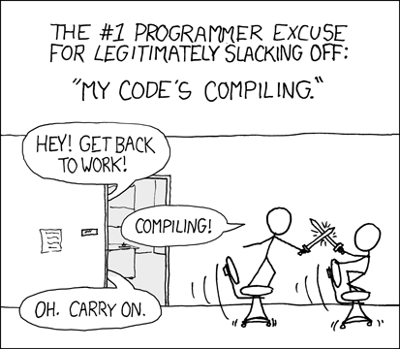
Questions, Comments, Concerns

